Slide 1

Enterprise Transformation Office and Corporate IT
- Access Card AS IS process

Slide 2
Access Card Process – Current Flow and Issues
Gate Entry
Controller
Spectra/BTG Server
Inter SFTP Server
Success Factor
Manual Entry
1
2
3
4
5
6
Associate Swipes at
the door IN/OUT
Controller checks the
Credentials of the
Associate and captures
Swipe IN/OUT data and Opens the door
Controller shares the swipe data immediately to Spectra Server
Data from Inter SFTP to Success Factor gets transferred everyday at 11AM
11 AM - Captures all the data from SFTP server
Manual Updates from Employee if SF does not reflect the right Swipe data
Data from Spectrum Server is shared with Intermediate Server at 10AM everyday.
Manual Updates from Employee
Controller checks the
Credentials of the
Associate and does not open the door if the Associate does not have access but captures the Transaction
HRSS team corrects the manual entry with the entry from the Swipe
Manual Updates from HRSS Team
If there are Network issues or Restart of server, then 10Am data server does not have all the data.
Frequent Data Loss resulting in Manual correction

Slide 3
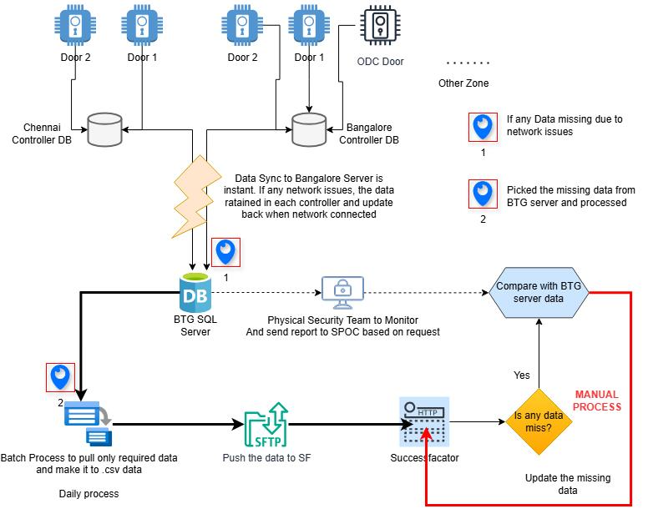
Access card process – As Is

Slide 4
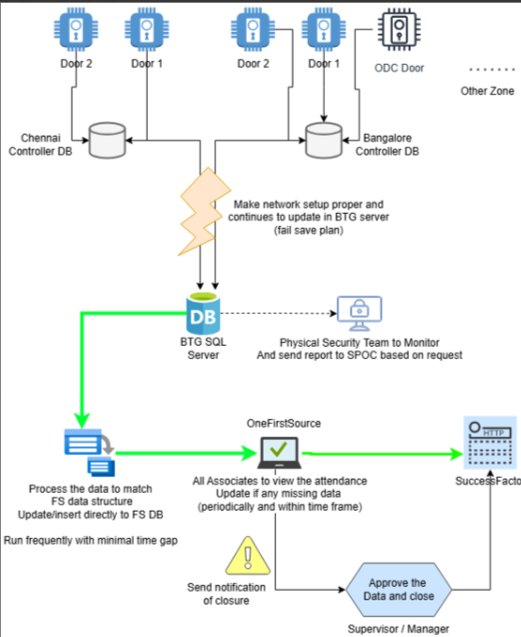
Access card process – To Be

Slide 5
Benefits:
Employee salary will be paid on time (Payroll process accuracy)*
Real time data view for all associates in SF*
Efficient Time Tracking : Reduces administrative time spent on attendance tracking, payroll processing, and auditing.
Associates to follow
Access: Associated is expected to check/monitor the IN/OUT details in SF on a daily basis and for any corrections OneFS will be the option to update/top up the total hrs.
Security process: Ensures only authorized employees can access OneFS
All associates should follow the compliance process of TS submission (Before Payroll cut individual hrs needs to be updated in One FS)

